Slide 1

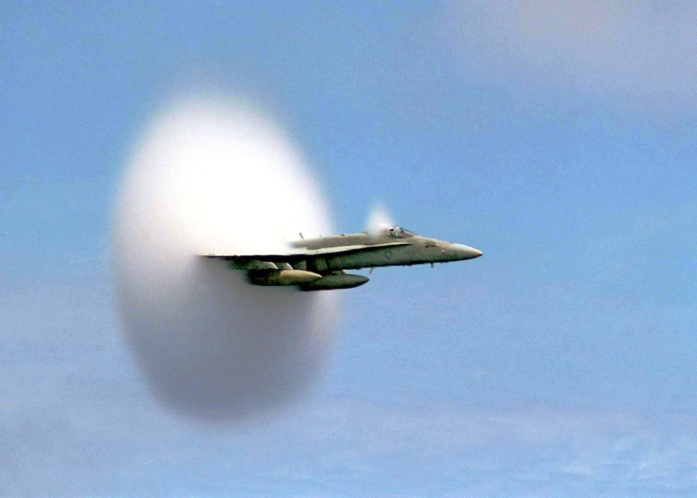
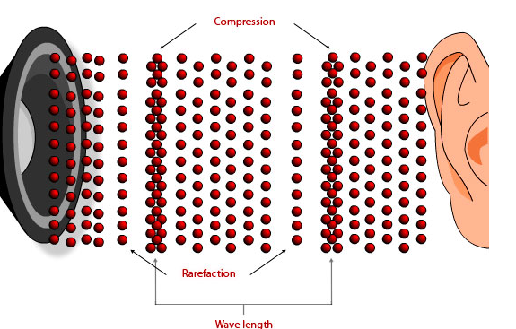
Sound

Slide 2
Properties of Sound
Sound is a longitudinal mechanical wave
It is made up of alternating regions of high pressure (compressions) and low pressure (rarefactions)
Sound cannot travel in empty space ( a vacuum)!

Slide 3
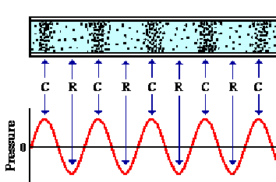
Sound is a Pressure Wave
http://www.physicsclassroom.com/class/sound/u11l1c.cfm

Slide 4

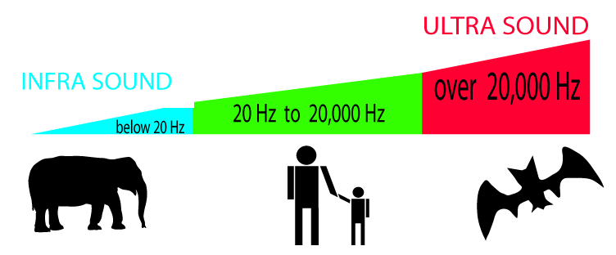
Sound Frequency
Hearing test….
Audible
Range:
20 Hz –
20 000 Hz
Why does hearing change with age?.....
Ultrasonic
>20 000 Hz
Infrasonic
<20 Hz

Slide 5

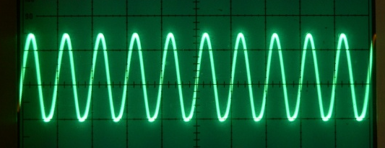
Quantitative and Qualitative Sound Terms:
Quantitative-
What we measure
Qualitative-
What we perceive
pitch
Frequency →
Intensity →
loudness

Slide 6
Sound Intensity
Sound intensity is a measure of the energy per unit area that passes a point per second
Units: W/m²
The human ear is incredibly versatile and
can detect sound between
1 x 10⁻¹² W/m² up to 100 W/m²

Slide 7
A more convenient scale is the logarithmic decibel (dB) scale-named after Alexander Graham Bell!
Recall: Exponents and logarithms:
10³=1000 log₁₀1000 = 3
The logarithm gives us the exponent to which the base must be raised to yield the given power.

Slide 8
Complete the Sound Intensity Chart below by referring to Page 326 (Section 10.1) in the Pearson Textbook:
Source of Sound | Intensity (W/m²) | Intensity (pW/m²) | Intensity Level (Bel or B) | Intensity Level (decibel or dB)
Threshold of human hearing | 10 ⁻¹² | 1=10⁰ | 0 | 0
Rustling Leaves | 10 ⁻¹¹ | 10=10¹ | 1 | 10
Whisper | 10⁻¹⁰ | 100=10² | 2 | 20
Empty Theatre |  |  | 3 | 30
Quiet Area at Night |  |  | 4 | 40
Average home |  |  | 5 | 50
Busy traffic-street level |  |  | 7 | 70
Vacuum cleaner |  |  | 8 | 80
Loud stereo in living room |  |  | 9 | 90
MP3 or Ipod player at max volume |  |  | 10 | 100
Front row of rock concert | 10⁻¹ | 10¹¹ | 11 | 110
Threshold of pain | 10⁰ | 10¹³ | 13 | 130

Slide 9
Intensity Changes:
Each 10 dB step on the decibel scale corresponds to a multiplication factor of 10!
Eg: How much more intense is a 80 dB sound than a 50 dB sound?
Ans: 80 dB- 50 dB = 30 dB
The 80 dB sound is 10x10x10 = 1000 times more intense.

Slide 10
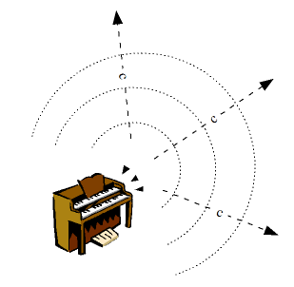
Speed of Sound
Sound generally travels faster in
in solids and slowest in gases
Eg:
v_{air} (0 ° C)=332 m/s
v_{water} (25 ° C)= 1493 m/s
V_{steel} =5790 m/s

Slide 11
Speed of Sound in Air
Speed of sound in air depends on
temperature:
V= 331.6 m/s + 0.606T
Where T is the temperature
measured in °C

Slide 12
Eg: What is the speed of sound in air if the temperature is:
a) 28 °C b) -15 °C
Answers:
a) 348.6 m/s b) 322.5 m/s

Slide 13
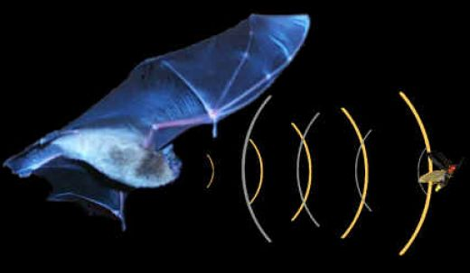
Echolocation
Sound will reflect
off objects
We call this an
echo if we hear sound come back
By timing the echo, we can determine how far away the reflector is

Slide 14
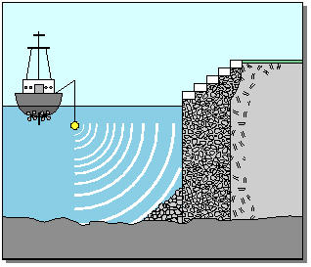
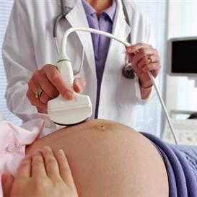
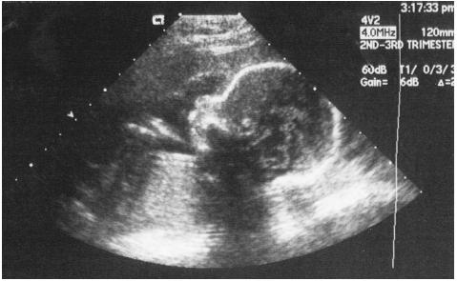
Echolocation
Bats
Human echolocation....
SONAR
Ultrasound Imaging

Slide 15

When calculating the echo time remember that the sound has travelled twice the distance!
Example: A student stands near the base of a cliff and claps her hands. She hears the echo in 3.0 s. Find the distance to the cliff if the speed of sound in air was 346.8 m/s that day.
Ans: 520 m

